Slide 1
Introduction to Machine Learning and Data Mining (Học máy và Khai phá dữ liệu)
Khoat Than
School of Information and Communication Technology
Hanoi University of Science and Technology

Slide 2
Content
Introduction to Machine Learning & Data Mining
Unsupervised learning
Supervised learning
Probabilistic modeling
Practical advice

Slide 3
Why probabilistic modeling?
Inferences from data are intrinsically uncertain. (suy diễn từ dữ liệu thường không chắc chắn)
Probability theory: model uncertainty instead of ignoring it!
Inference or prediction can be done by using probabilities.
Applications: Machine Learning, Data Mining, Computer Vision, NLP, Bioinformatics, …
The goal of this lecture
Overview about probabilistic modeling
Key concepts
Application to classification & clustering

Slide 4
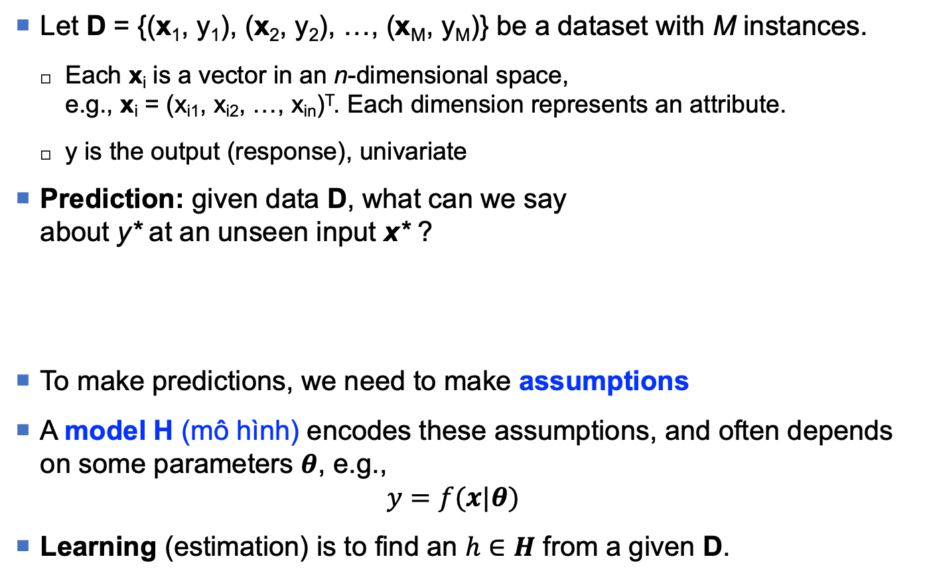
Data
Let D = {(x₁, y₁), (x₂, y₂), …, (x_{M}, y_{M})} be a dataset with M instances.
Each x_{i} is a vector in an n-dimensional space, e.g., x_{i} = (x_{i1}, x_{i2}, …, x_{in})^{T}. Each dimension represents an attribute.
y is the output (response), univariate
Prediction: given data D, what can we say about y* at an unseen input x* ?
To make predictions, we need to make assumptions
A model H (mô hình) encodes these assumptions, and often depends on some parameters $θ$, e.g.,
$$y=f(x|θ)$$
Learning (estimation) is to find an $h∈H$ from a given D.
y
?
x*
x

Slide 5
Uncertainty
Uncertainty apprears in any step
Measurement uncertainty (D)
Parameter uncertainty (θ)
Uncertainty regarding the correct model (H)
Measurement uncertainty
Uncertainty can occur in both inputs and outputs.
How to represent uncertainty?
→ Probability theory
y
x

Slide 6
The modeling process
Model making
Learning, inference
[Blei, 2012]

Slide 7
Basics of Probability Theory

Slide 8
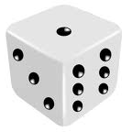
Basic concepts in Probability Theory
Assume we do an experiment with random outcomes, e.g., tossing a die.
Space S of outcomes: the set of all possible outcomes of an experiment
Ex: S = {1, 2, 3, 4, 5, 6} for tossing a die
Event E: a subset of the outcome space S.
Ex: E = {1} the event that the die appears 1.
Ex: E = {1, 3, 5} the event that the die appears odd.
Space W of events: the space of all possible events
Ex: W contains all possible tosses
Random variable: represents a random event, and has an associated probability of occurrence of that event.

Slide 9
Probability visualization
Probability represents the likelihood/possibility that an event A occurs.
Denoted by P(A).
P(A) is the proportion of the subspace that A is true.
The event space
(space of all possible outcomes of the event A)
A false
A true

Slide 10
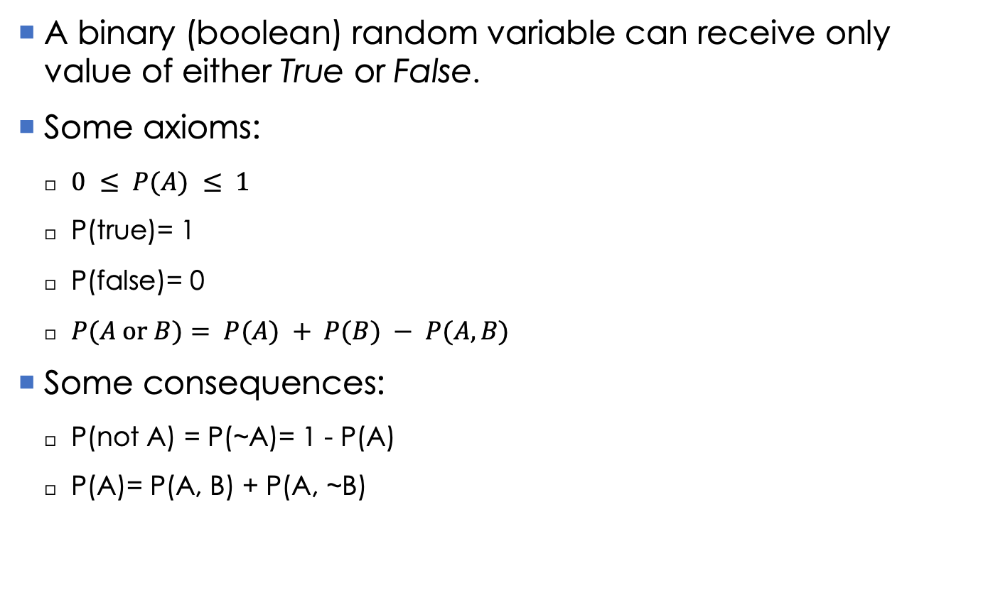
Binary random variables
A binary (boolean) random variable can receive only value of either True or False.
Some axioms:
$0 ≤ P(A) ≤ 1$
P(true)= 1
P(false)= 0
$P(A or B)= P(A) + P(B) − P(A, B)$
Some consequences:
P(not A) = P(~A)= 1 - P(A)
P(A)= P(A, B) + P(A, ~B)

Slide 11
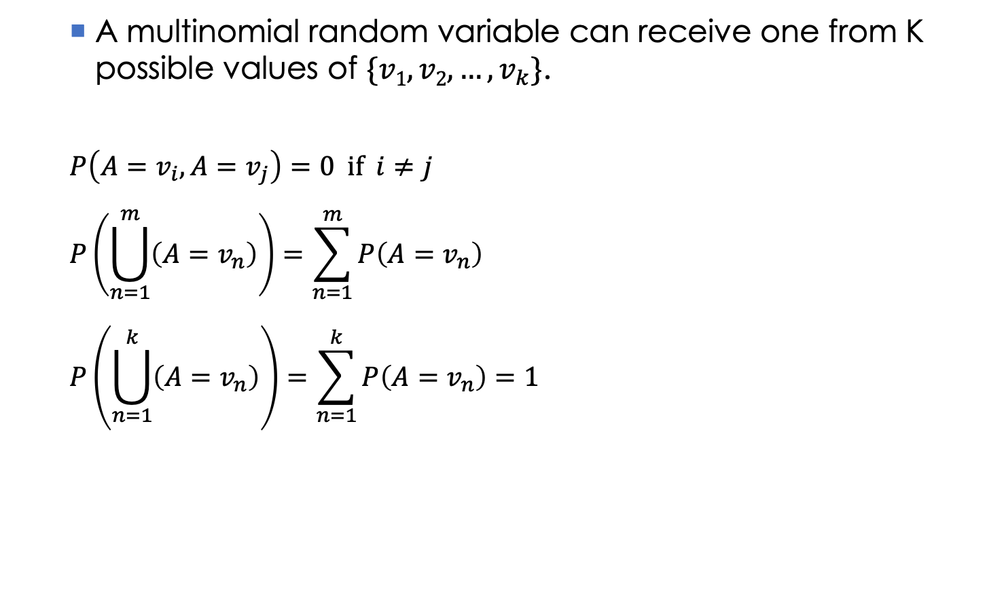
Multinomial random variables
A multinomial random variable can receive one from K possible values of $\{v1, v2,…, v_{k}\}$.
$$P\left(A=v_{i}, A=v_{j}\right)=0 if i≠j$$
$$P\left(\bigcup_{n=1}^{m}{\left(A=v_{n}\right)}\right)=\sum_{n=1}^{m}{P\left(A=v_{n}\right)}$$
$$P\left(\bigcup_{n=1}^{k}{\left(A=v_{n}\right)}\right)=\sum_{n=1}^{k}{P\left(A=v_{n}\right)}=1$$

Slide 12
Joint probability (1)
Joint probability:
The possibility of A and B that occur simutaneously.
P(A,B) is the proportion of the space in which both A and B are true.
Ex:
A: I will play football tomorrow.
B: John will not play football.
P(A,B): the probability that I will but John will not play football tomorrow.
B space
A true
B true
A space

Slide 13
Joint probability (2)
Denote S_{A} the space of A.
Denote S_{B} the space of B.
Denote S_{AB} the space of (A, B).
S_{AB} = S_{A} ✕ S_{B}
Then:
P(A,B) = |T_{AB}| / |S_{AB}|
T_{AB} is the space in which both A and B are true.
|X| denotes the volumn of the set X.
B space
A true
B true
A space

Slide 14
Conditional probability (1)
Conditional probability:
P(A|B): the possibility that A happens given that B has already occurred.
P(A|B) is the proportion of the space in which A occurs, knowing that B is true.
Ex:
A: I will play football tomorrow.
B: it will not rain tomorrow.
P(A|B): the probability that I will play football, provided that it will not rain tomorrow.
What is different between joint and conditional probabilities?

Slide 15
Conditional probability (2)
We have:
Some consequences:
P(A,B) = P(A|B) . P(B)
P(A|B) + P(~A|B) = 1
B space
A true
B true
A space

Slide 16
Conditional probability (3)
P(A|B, C) shows the probability of A given that B and C already has occurred.
Ex:
A: I will wander over the near river tomorrow morning.
B: it will be very nice tomorrow morning.
C: I will wake up early tomorrow morning.
P(A|B, C): the probability that wander over the near river, provided that it will be very nice and I will wake up early tomorrow morning.
B
C
A
P(A|B,C)

Slide 17
Statistical independence (1)
Two events A and B are called Statistically Independent if the the probability that A occurs does not change with respect to the occurrence of B.
P(A|B) = P(A).
Ex:
A: I will play football tomorrow.
B: the pacific ocean contains many fishes.
P(A|B) = P(A): the fact that the pacific ocean contains many fishes does not affect my decision to play football tomorrow.

Slide 18
Statistical independence (2)
Assume P(A|B) = P(A), we have:
P(~A|B) = P(~A)
P(B|A) = P(B)
P(A,B) = P(A). P(B)
P(~A,B) = P(~A). P(B)
P(A,~B) = P(A). P(~B)
P(~A,~B) = P(~A). P(~B).

Slide 19
Conditional independence
Two events A and C are called Conditionally Independent given B if P(A|B, C) = P(A|B).
Ex:
A: I will play football tomorrow.
B: the football match will happen in-house tomorrow.
C: it will not rain tomorrow.
P(A|B, C) = P(A|B).

Slide 20
Some rules in probability theory
Chain rules:
P(A,B) = P(A|B).P(B) = P(B|A).P(A)= P(B,A)
P(A|B) = P(A,B)/P(B) = P(B|A).P(A)/P(B)
P(A,B|C) = P(A,B,C)/P(C) = P(A|B,C).P(B,C)/P(C)
= P(A|B,C).P(B|C).
Independence:
P(A|B) = P(A) if A and B are statistically independent.
P(A,B|C) = P(A|C).P(B|C) if A and B are statistically independent, conditioned on C.
P(A₁,…,A_{n}|C) = P(A₁|C)…P(A_{n}|C) if A₁,…,A_{n} are statistically independent, conditioned on C.

Slide 21
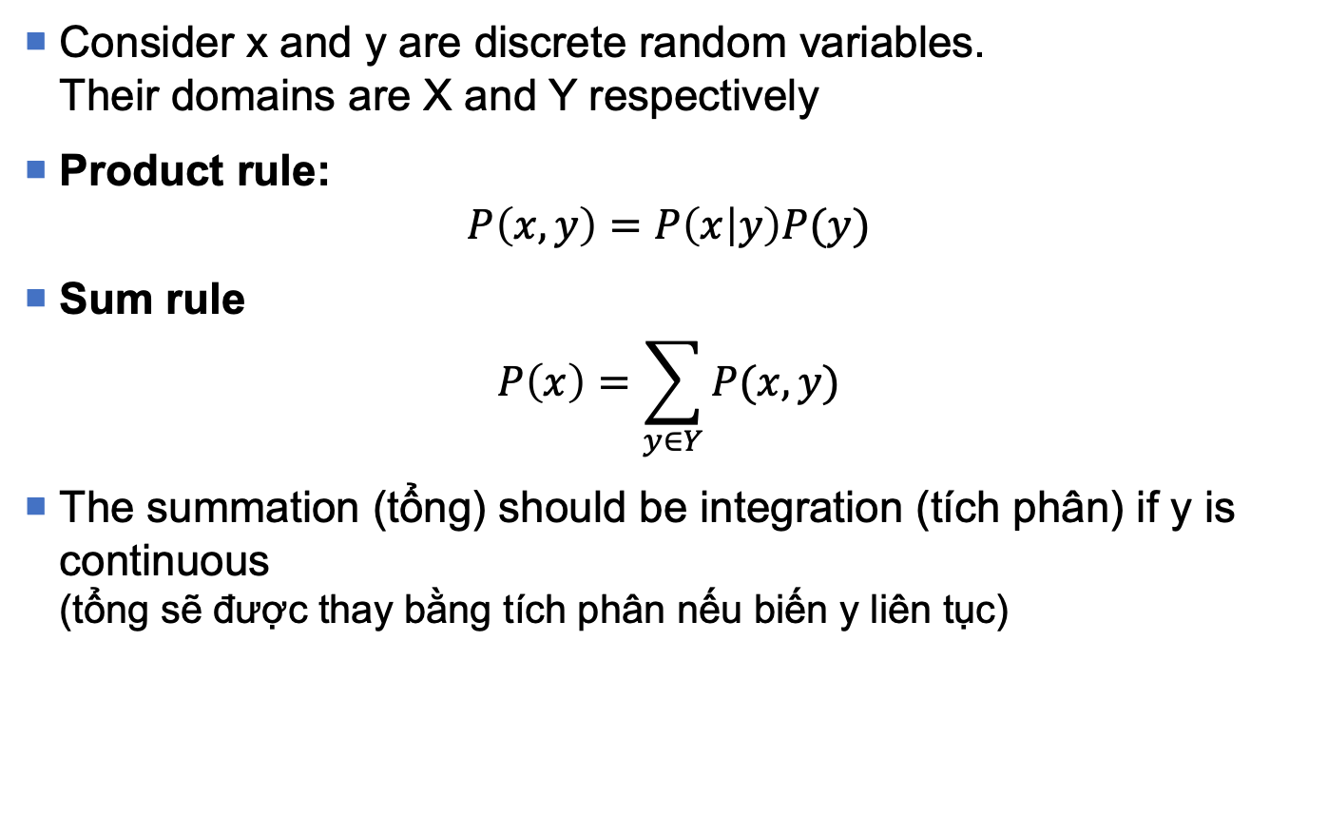
Product and sum rules
Consider x and y are discrete random variables. Their domains are X and Y respectively
Product rule:
$$P\left(x,y\right)=P\left(x | y\right)P(y)$$
Sum rule
$$P\left(x\right)=\sum_{y∈Y}{P(x,y)}$$
The summation (tổng) should be integration (tích phân) if y is continuous (tổng sẽ được thay bằng tích phân nếu biến y liên tục)

Slide 22
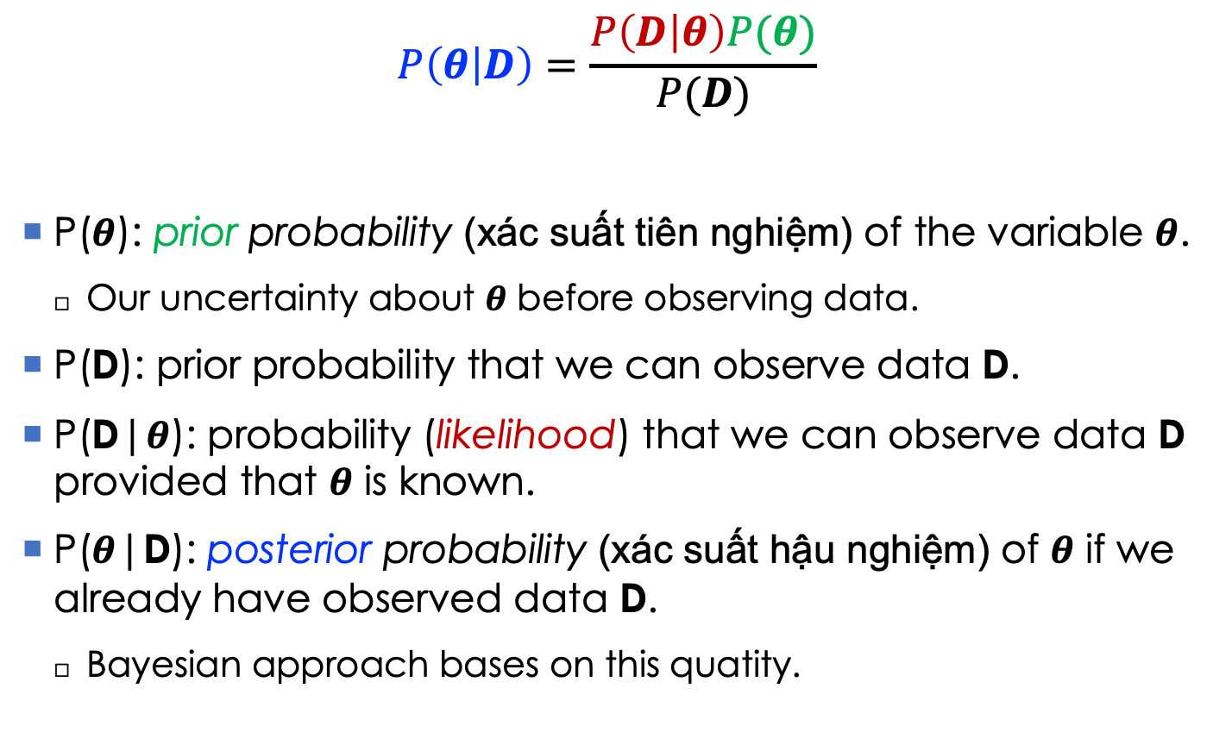
Bayes’ rule
$$P\left(θ | D\right)=\frac{P\left(D | θ\right)P(θ)}{P(D)}$$
P($θ$): prior probability (xác suất tiên nghiệm) of the variable $θ$.
Our uncertainty about $θ$ before observing data.
P(D): prior probability that we can observe data D.
P(D|$θ$): probability (likelihood) that we can observe data D provided that $θ$ is known.
P($θ$|D): posterior probability (xác suất hậu nghiệm) of $θ$ if we already have observed data D.
Bayesian approach bases on this quatity.

Slide 23
Probabilistic models
Model, inference, learning

Slide 24

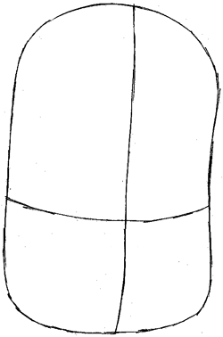
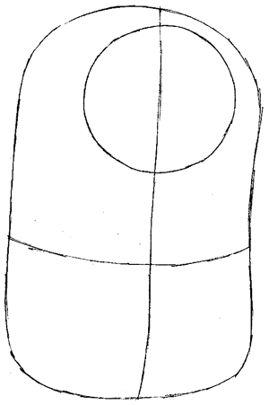
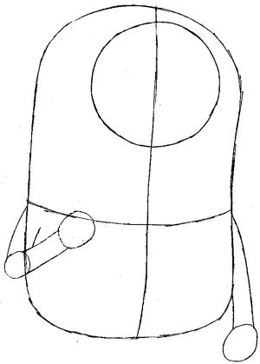
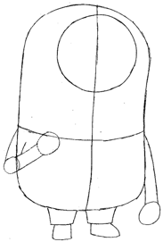

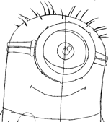
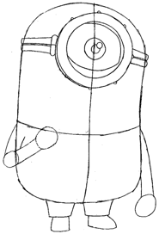
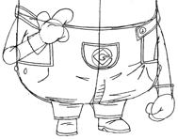
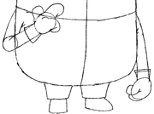
Probabilistic model
Our assumption on how the data were generated (giả thuyết của chúng ta về quá trình dữ liệu đã được sinh ra như thế nào)
Example: how a sentence is generated?
We assume our brain does as follow:
First choose the topic of the sentence
Generate the words one-by-one to form the sentence
How will TIM be drawn?
1.
2.
3.
4.
8.
7.
6.
5.
drawinghowtodraw.com

Slide 25
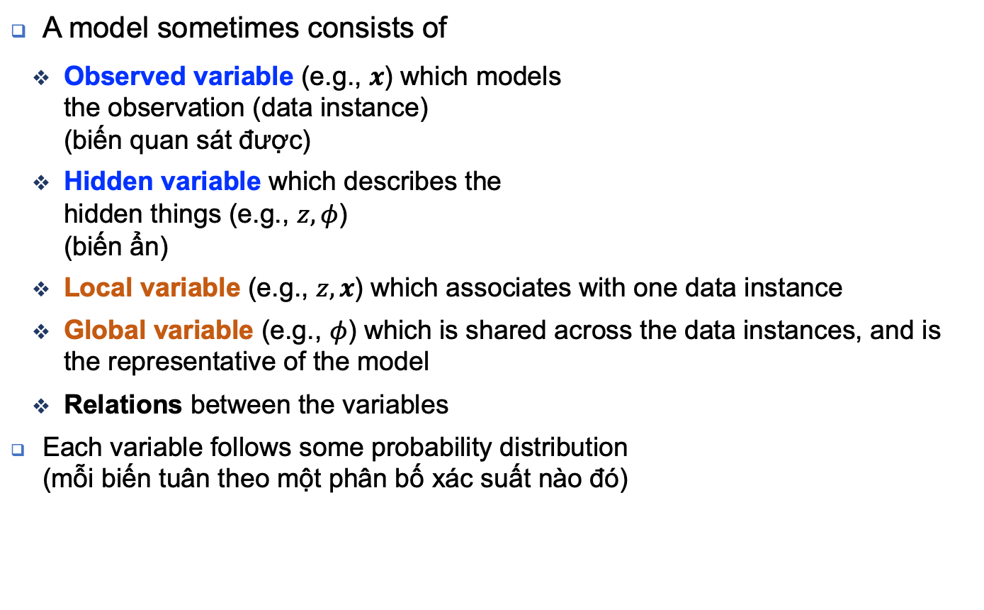


Probabilistic model
A model sometimes consists of
Observed variable (e.g., $x$) which models the observation (data instance) (biến quan sát được)
Hidden variable which describes the hidden things (e.g., $z,φ$) (biến ẩn)
Local variable (e.g., $z,x$) which associates with one data instance
Global variable (e.g., $φ$) which is shared across the data instances, and is the representative of the model
Relations between the variables
Each variable follows some probability distribution (mỗi biến tuân theo một phân bố xác suất nào đó)
$$α$$
$$φ$$
z
x
N

Slide 26


Different types of models
Probabilistic graphical model (PGM): Graph + Probability Theory (mô hình đồ thị xác suất)
Each vertex represents a random variable, grey circle means “observed”, white circle means “latent”
Each edge represents the conditional dependence between two variables
Directed graphical model: each edge has a direction
Undirected graphical model: no direction in the edges
Latent variable model: a PGM which has at least one latent variable
Bayesian model: a PGM which has a prior distribution on its parameter
$$α$$
$$φ$$
z
x
N

Slide 27
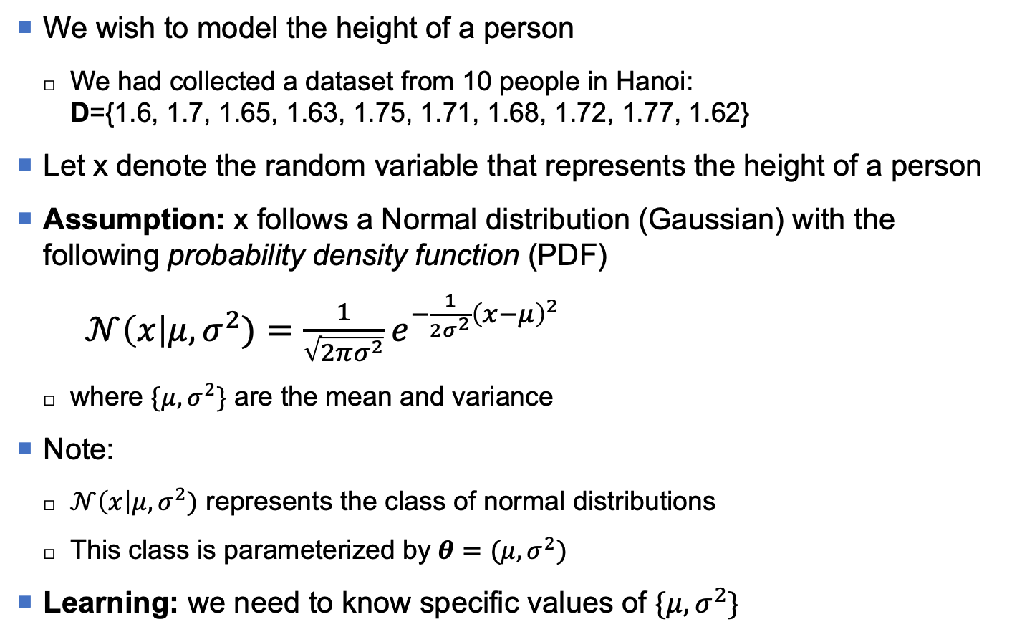


Univariate normal distribution
We wish to model the height of a person
We had collected a dataset from 10 people in Hanoi: D={1.6, 1.7, 1.65, 1.63, 1.75, 1.71, 1.68, 1.72, 1.77, 1.62}
Let x denote the random variable that represents the height of a person
Assumption: x follows a Normal distribution (Gaussian) with the following probability density function (PDF)
$𝒩\left(x\right|μ,σ^{2})=\frac{1}{\sqrt{2πσ^{2}}}e^{−\frac{1}{2σ^{2}}{\left(x−μ\right)}^{2}}$
where $\{μ,σ^{2}\}$ are the mean and variance
Note:
$𝒩\left(x\right|μ,σ^{2})$ represents the class of normal distributions
This class is parameterized by $θ=(μ,σ^{2})$
Learning: we need to know specific values of $\{μ,σ^{2}\}$
x
$$μ$$
$$σ^{2}$$

Slide 28
Univariate Gaussian mixture model (1)
We wish to model the height of a person
We had collected a dataset from 10 people in Hanoi + 10 people in Sydney D={1.6, 1.7, 1.65, 1.63, 1.75, 1.71, 1.68, 1.72, 1.77, 1.62, 1.75, 1.80, 1.85, 1.65, 1.91, 1.78, 1.88, 1.79, 1.82, 1.81}
Let x denote the random variable that represents the height
If we use Normal distribution:
Blue curve models the height in Hanoi
Orange curve models the height in Sydney
Green curve models the whole D
Univariate Gaussian does not model well the underlying distribution
Mixture model? (mô hình hỗn hợp)

Slide 29
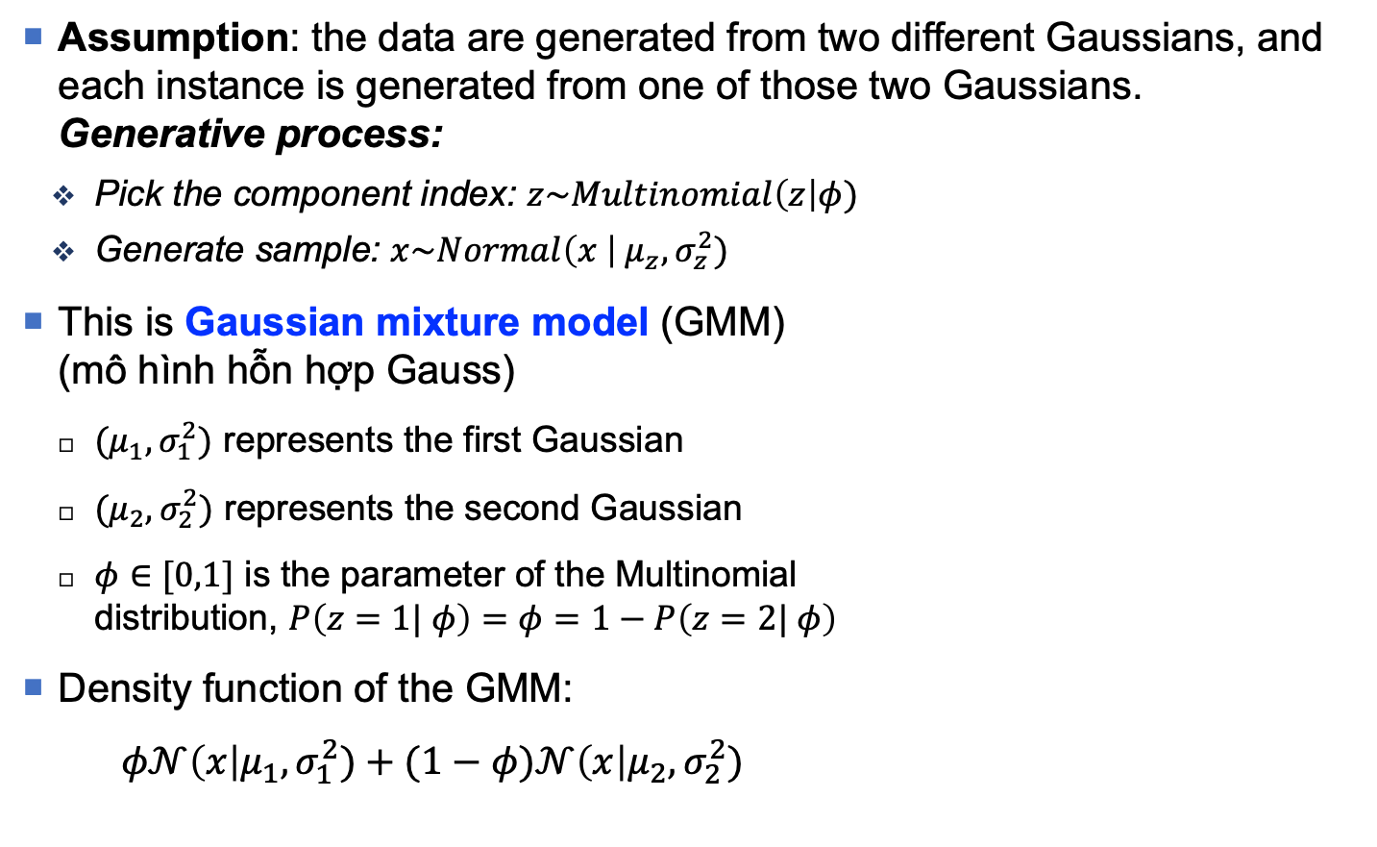
Univariate Gaussian mixture model (2)
Assumption: the data are generated from two different Gaussians, and each instance is generated from one of those two Gaussians. Generative process:
Pick the component index: $z\sim Multinomial\left(z\right|φ)$
Generate sample: $x\sim Normal\left(x \right|{ μ}_{z}, σ_{z}^{2})$
This is Gaussian mixture model (GMM) (mô hình hỗn hợp Gauss)
${(μ}_{1},σ_{1}^{2})$ represents the first Gaussian
${(μ}_{2},σ_{2}^{2})$ represents the second Gaussian
$φ∈[0,1]$ is the parameter of the Multinomial distribution, $P\left(z=1| φ\right)=φ=1−P\left(z=2| φ\right)$
Density function of the GMM:
$φ𝒩\left(x\right|μ_{1},σ_{1}^{2})+(1−φ)𝒩\left(x\right|μ_{2},σ_{2}^{2})$
Note: $“\sim ”$ means “follows” (tuân theo)

Slide 30
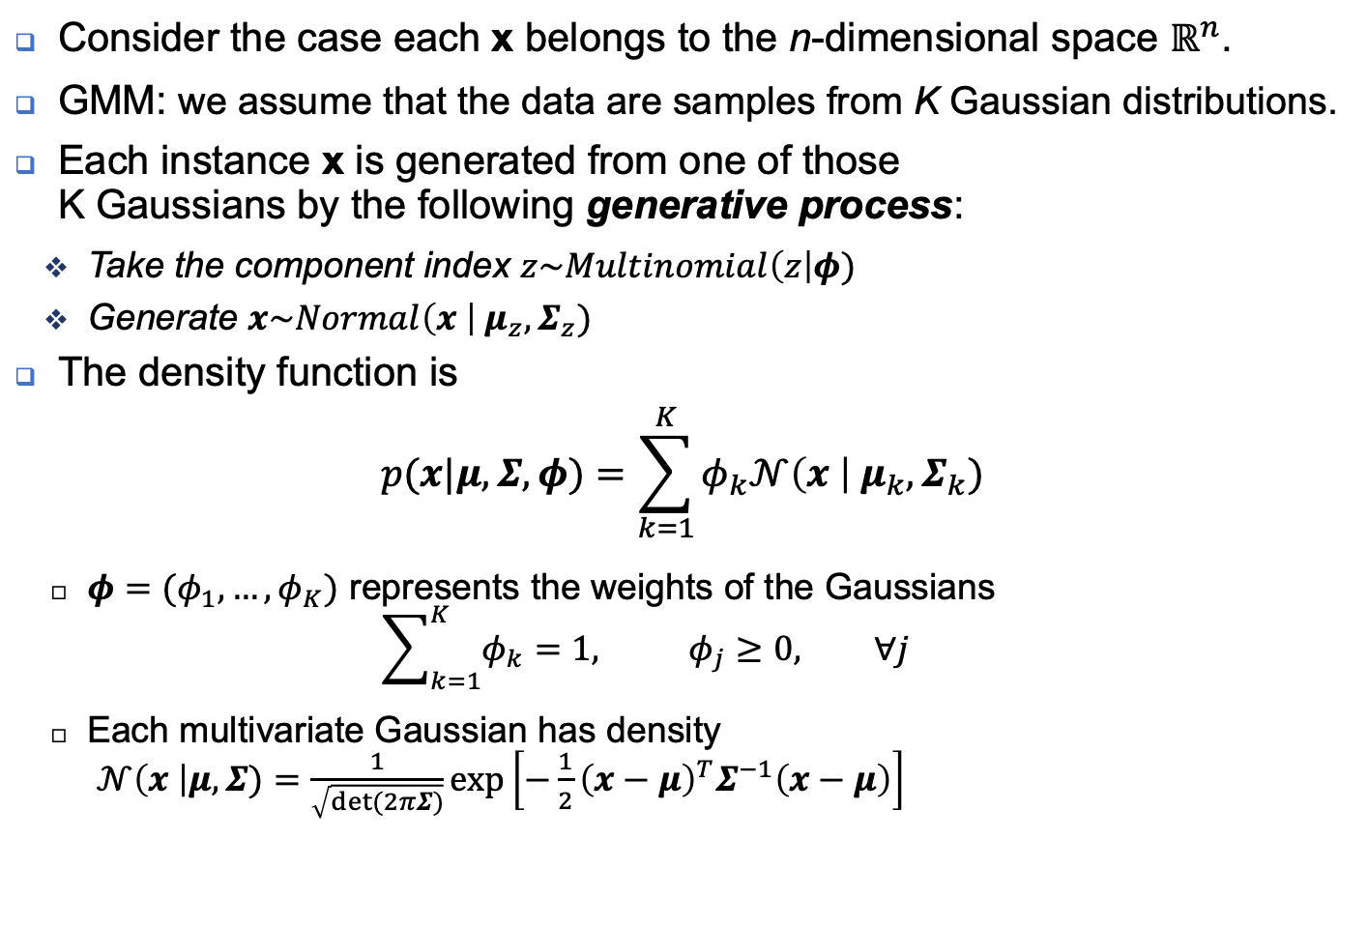



GMM: Multivariate case
Consider the case each x belongs to the n-dimensional space $ℝ^{n}$.
GMM: we assume that the data are samples from K Gaussian distributions.
Each instance x is generated from one of those K Gaussians by the following generative process:
Take the component index $z\sim Multinomial\left(z\right|φ)$
Generate $x\sim Normal\left(x \right|{ μ}_{z}, Σ_{z})$
The density function is
$$p(x|μ,Σ,φ)=\sum_{k=1}^{K}{φ_{k}𝒩\left(x \right|{ μ}_{k}, Σ_{k})}$$
$φ=(φ_{1},…,φ_{K})$ represents the weights of the Gaussians ${\sum_{k=1}^{K}{φ_{k}}=1, φ}_{j}≥0, ∀j$
Each multivariate Gaussian has density $𝒩\left(x \right|μ,Σ)=\frac{1}{\sqrt{det⁡(2πΣ)}}exp⁡\left[−\frac{1}{2}{\left(x−μ\right)}^{T}Σ^{−1}\left(x−μ\right)\right]$
$$φ$$
z
x
$$μ$$
$$Σ$$
K

Slide 31
PGM: some well-known models
Gaussian mixture model (GMM)
Modeling real-valued data
Latent Dirichlet allocation (LDA)
Modeling the topics hidden in textual data
Hidden Markov model (HMM)
Modeling time-series, i.e., data with time stamps or sequential nature
Conditional Random Field (CRF)
for structured prediction
Deep generative models
Modeling the hidden structures, generating artificial data

Slide 32
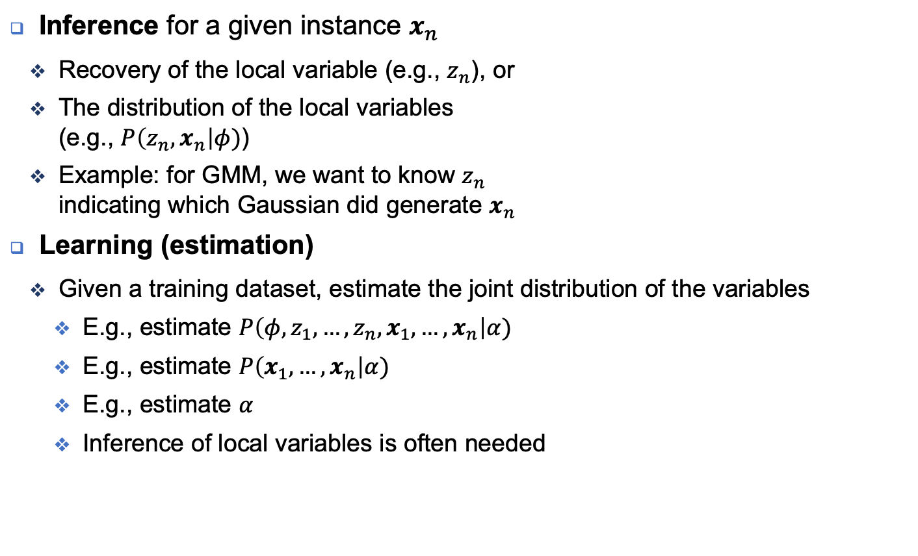
Probabilistic model: two problems
Inference for a given instance $x_{n}$
Recovery of the local variable (e.g., $z_{n}$), or
The distribution of the local variables (e.g., $P\left(z_{n},x_{n}\right|φ)$)
Example: for GMM, we want to know $z_{n}$ indicating which Gaussian did generate $x_{n}$
Learning (estimation)
Given a training dataset, estimate the joint distribution of the variables
E.g., estimate $P\left(φ,z_{1},…,z_{n},x_{1},…,x_{n}\right|α)$
E.g., estimate $P\left(x_{1},…,x_{n}\right|α)$
E.g., estimate $α$
Inference of local variables is often needed
$$α$$
$$φ$$
z
x
N

Slide 33
Inference and Learning
MLE, MAP

Slide 34
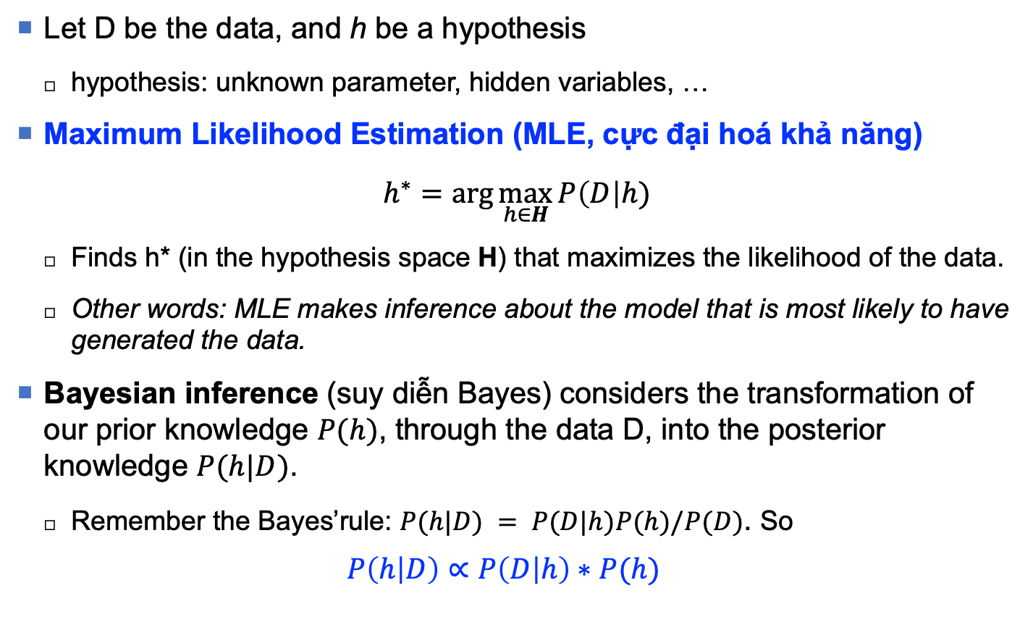

Some inference approaches (1)
Let D be the data, and h be a hypothesis
hypothesis: unknown parameter, hidden variables, …
Maximum Likelihood Estimation (MLE, cực đại hoá khả năng)
$$h^{∗}=\arg{\max_{h∈H}{P\left(D\right|h)}}$$
Finds h* (in the hypothesis space H) that maximizes the likelihood of the data.
Other words: MLE makes inference about the model that is most likely to have generated the data.
Bayesian inference (suy diễn Bayes) considers the transformation of our prior knowledge $P(h)$, through the data D, into the posterior knowledge $P(h|D)$.
Remember the Bayes’rule: $P(h|D) = P(D|h)P(h)/P(D)$. So
$$P\left(h | D\right)∝P\left(D | h\right)∗P(h)$$
(Posterior $∝$ Likelihood * Prior)

Slide 35
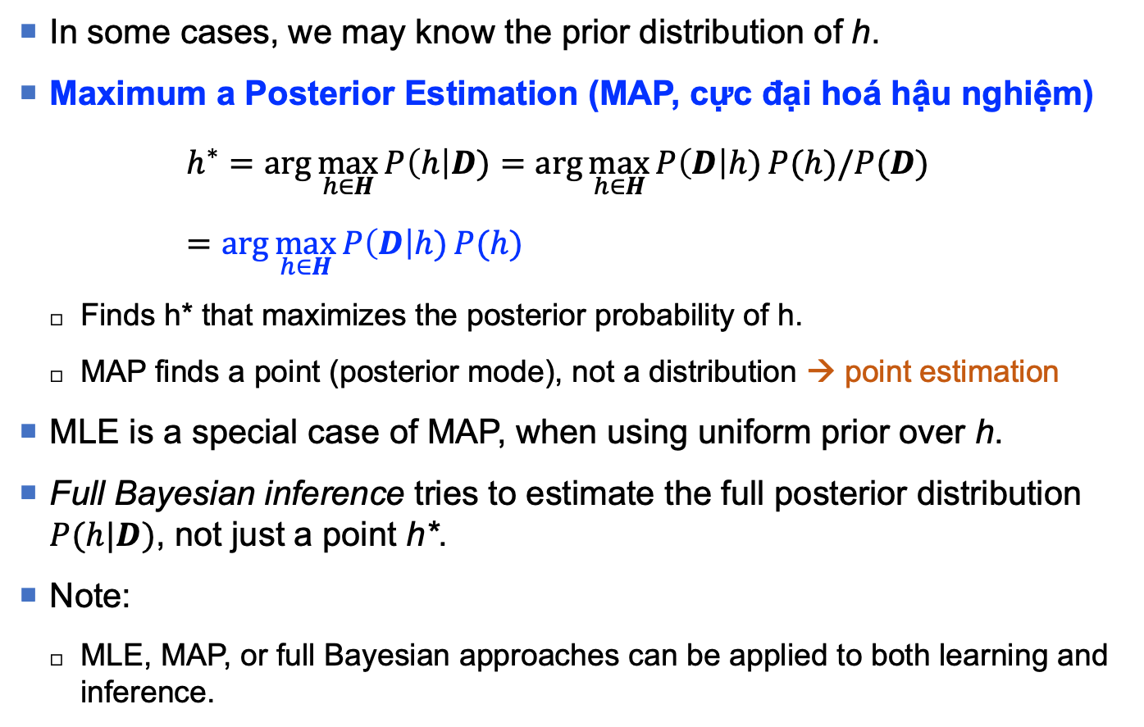
Some inference approaches (2)
In some cases, we may know the prior distribution of h.
Maximum a Posterior Estimation (MAP, cực đại hoá hậu nghiệm)
$$h^{∗}=\arg{\max_{h∈H}{P\left(h\right|D)}}=\arg{\max_{h∈H}{P\left(D\right|h)}P(h)/P(D)} =\arg{\max_{h∈H}{P\left(D\right|h)}P(h)}$$
Finds h* that maximizes the posterior probability of h.
MAP finds a point (posterior mode), not a distribution → point estimation
MLE is a special case of MAP, when using uniform prior over h.
Full Bayesian inference tries to estimate the full posterior distribution $P(h|D)$, not just a point h*.
Note:
MLE, MAP, or full Bayesian approaches can be applied to both learning and inference.

Slide 36
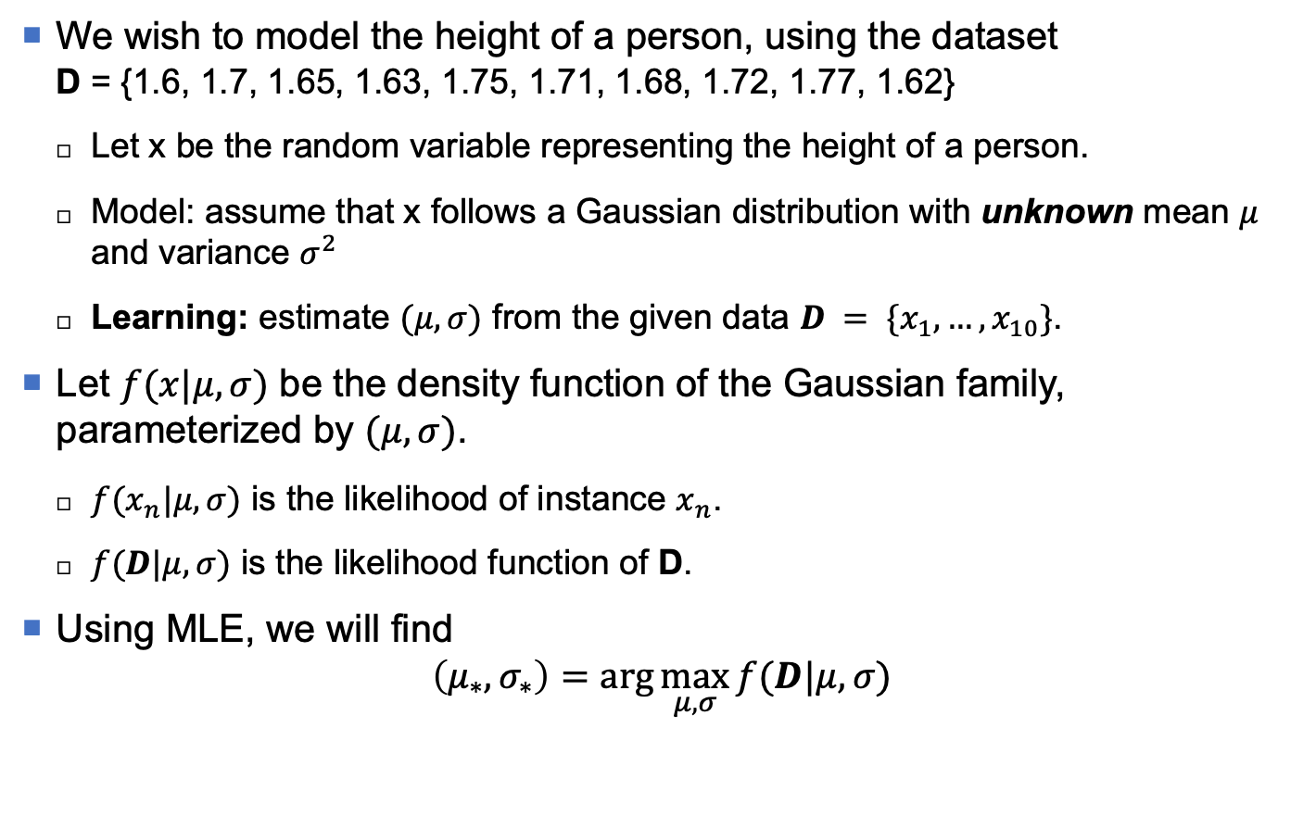
MLE: Gaussian example (1)
We wish to model the height of a person, using the dataset D = {1.6, 1.7, 1.65, 1.63, 1.75, 1.71, 1.68, 1.72, 1.77, 1.62}
Let x be the random variable representing the height of a person.
Model: assume that x follows a Gaussian distribution with unknown mean $μ$ and variance $σ^{2}$
Learning: estimate $(μ,σ)$ from the given data $D = \{x_{1},…,x_{10}\}$.
Let $f(x|μ,σ)$ be the density function of the Gaussian family, parameterized by $(μ,σ)$.
$f(x_{n}|μ,σ)$ is the likelihood of instance $x_{n}$.
$f(D|μ,σ)$ is the likelihood function of D.
Using MLE, we will find
$$\left(μ_{∗},σ_{∗}\right)=\arg{\max_{μ,σ}{f(D|μ,σ)}}$$

Slide 37
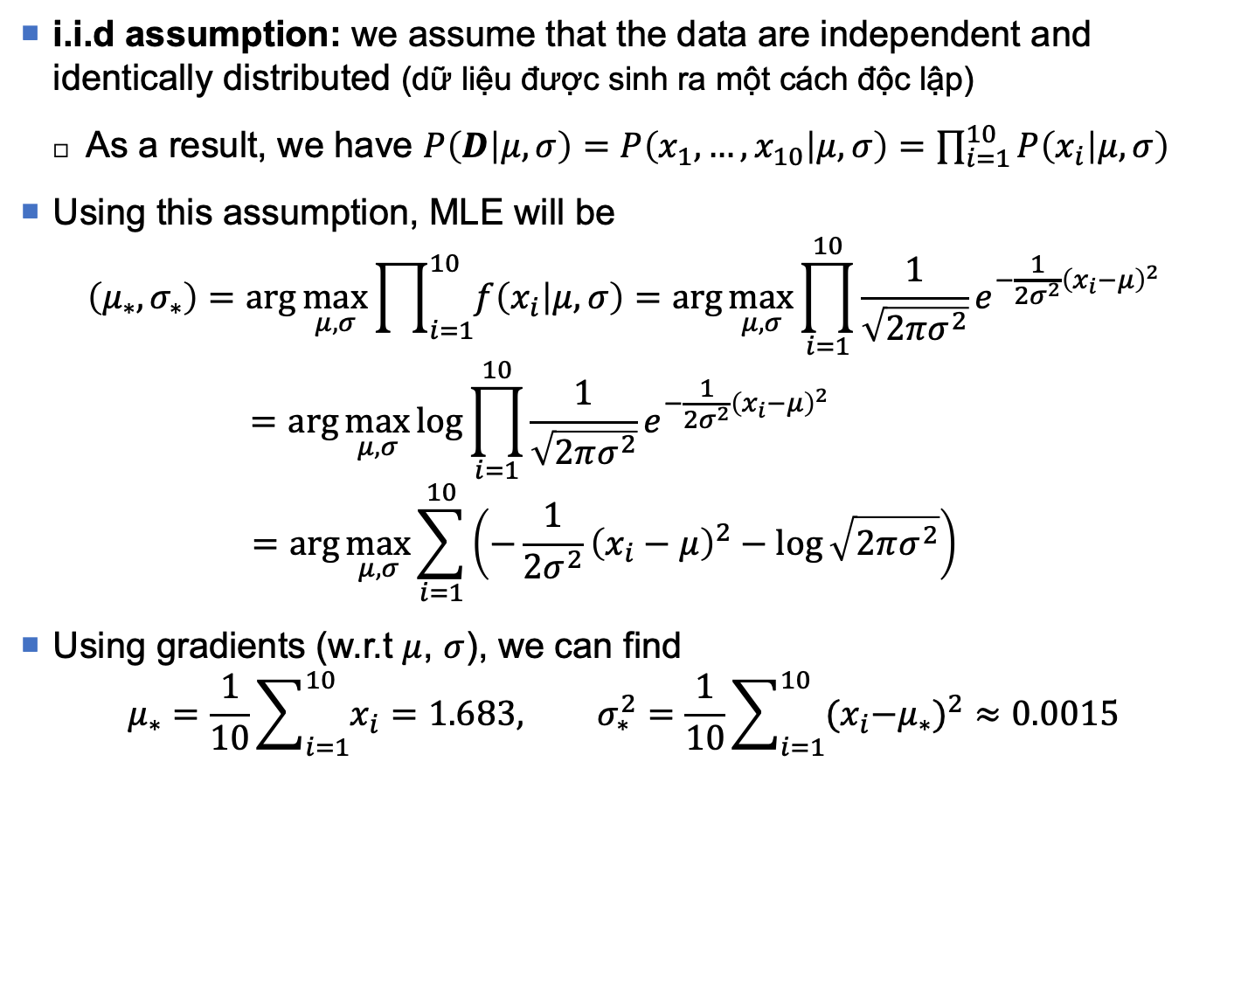
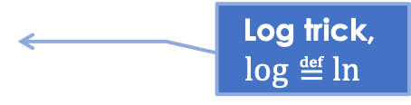
MLE: Gaussian example (2)
i.i.d assumption: we assume that the data are independent and identically distributed (dữ liệu được sinh ra một cách độc lập)
As a result, we have $P\left(D | μ,σ\right)=P\left(x_{1},…,x_{10} | μ,σ\right)=\prod_{i=1}^{10}{P\left(x_{i} | μ,σ\right)}$
Using this assumption, MLE will be
$$\left(μ_{∗},σ_{∗}\right)=\arg{\max_{μ,σ}{\prod_{i=1}^{10}{f\left(x_{i} | μ,σ\right)}}}=\arg{\max_{μ,σ}{\prod_{i=1}^{10}{\frac{1}{\sqrt{2πσ^{2}}}e^{−\frac{1}{2σ^{2}}{\left(x_{i}−μ\right)}^{2}}}}}$$
$$=\arg{\max_{μ,σ}{\log{\prod_{i=1}^{10}{\frac{1}{\sqrt{2πσ^{2}}}e^{−\frac{1}{2σ^{2}}{\left(x_{i}−μ\right)}^{2}}}}}}$$
$$=\arg{\max_{μ,σ}{\sum_{i=1}^{10}{\left(−\frac{1}{2σ^{2}}{\left(x_{i}−μ\right)}^{2}−\log{\sqrt{2πσ^{2}}}\right)}{}}}$$
Using gradients (w.r.t $μ$, $σ$), we can find
$$μ_{∗}=\frac{1}{10}\sum_{i=1}^{10}{x_{i}}=1.683, σ_{∗}^{2}=\frac{1}{10}\sum_{i=1}^{10}{{{(x}_{i}−μ_{∗})}^{2}}≈0.0015$$
Log trick,
$$\log{≝}\ln{ }$$

Slide 38
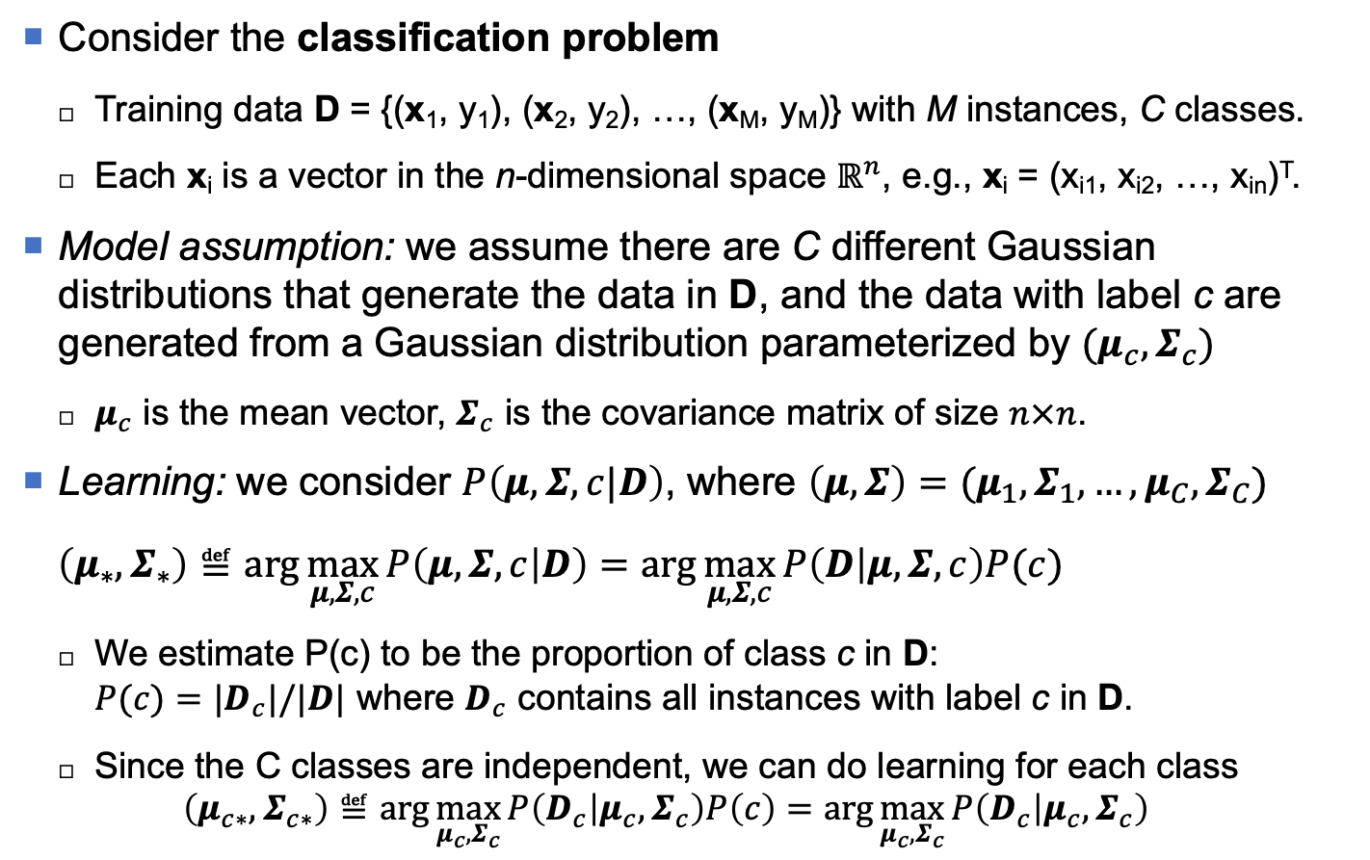
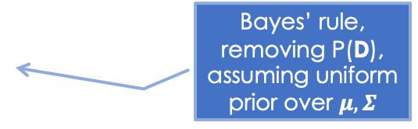
MAP: Gaussian Naïve Bayes (1)
Consider the classification problem
Training data D = {(x₁, y₁), (x₂, y₂), …, (x_{M}, y_{M})} with M instances, C classes.
Each x_{i} is a vector in the n-dimensional space $ℝ^{n}$, e.g., x_{i} = (x_{i1}, x_{i2}, …, x_{in})^{T}.
Model assumption: we assume there are C different Gaussian distributions that generate the data in D, and the data with label c are generated from a Gaussian distribution parameterized by $(μ_{c},Σ_{c})$
$μ_{c}$ is the mean vector, $Σ_{c}$ is the covariance matrix of size $n×n$.
Learning: we consider $P\left(μ,Σ,c|D\right)$, where $\left(μ,Σ\right)=(μ_{1},Σ_{1},…,μ_{C},Σ_{C})$
$$\left(μ_{∗},Σ_{∗}\right)≝\arg{\max_{μ,Σ,c}{P\left(μ,Σ,c | D\right)}}=\arg{\max_{μ,Σ,c}{P\left(D | μ,Σ,c\right)P(c) }}$$
We estimate P(c) to be the proportion of class c in D: $P(c)=|D_{c}|/|D|$ where $D_{c}$ contains all instances with label c in D.
Since the C classes are independent, we can do learning for each class
$$\left(μ_{c∗},Σ_{c∗}\right)≝\arg{\max_{μ_{c},Σ_{c}}{P\left(D_{c} | μ_{c},Σ_{c}\right)P\left(c\right)}}=\arg{\max_{μ_{c},Σ_{c}}{P\left(D_{c} | μ_{c},Σ_{c}\right) }}$$
Bayes’ rule, removing P(D), assuming uniform prior over $μ,Σ$

Slide 39
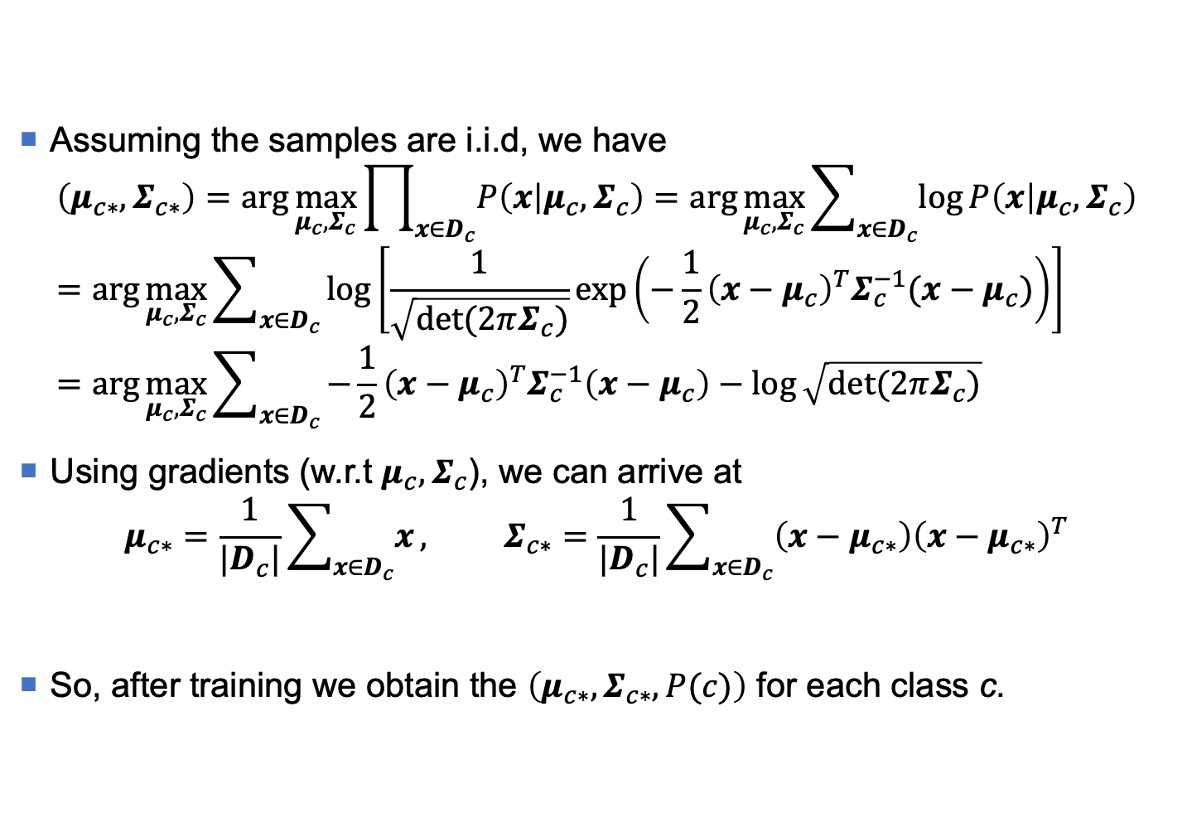
MAP: Gaussian Naïve Bayes (2)
Assuming the samples are i.i.d, we have
$$\left(μ_{c∗},Σ_{c∗}\right)=\arg{\max_{μ_{c},Σ_{c}}{\prod_{x∈D_{c}}{P\left(x | μ_{c},Σ_{c}\right)}}}=\arg{\max_{μ_{c},Σ_{c}}{\sum_{x∈D_{c}}{\log{P\left(x | μ_{c},Σ_{c}\right)}}}}=\arg{\max_{μ_{c},Σ_{c}}{\sum_{x∈D_{c}}{\log\left[\frac{1}{\sqrt{\det{(2πΣ_{c})}}}\exp\left(−\frac{1}{2}{\left(x−μ_{c}\right)}^{T}Σ_{c}^{−1}(x−μ_{c})\right)\right]}}}=\arg{\max_{μ_{c},Σ_{c}}{\sum_{x∈D_{c}}{−\frac{1}{2}{\left(x−μ_{c}\right)}^{T}Σ_{c}^{−1}\left(x−μ_{c}\right)−log{\sqrt{\det{(2πΣ_{c})}}}}}}$$
Using gradients (w.r.t $μ_{c},Σ_{c}$), we can arrive at
$$μ_{c∗}=\frac{1}{|D_{c}|}\sum_{x∈D_{c}}{x}, Σ_{c∗}=\frac{1}{|D_{c}|}\sum_{x∈D_{c}}{\left(x−μ_{c∗}\right){\left(x−μ_{c∗}\right)}^{T}}$$
So, after training we obtain the $\left(μ_{c∗},Σ_{c∗},P(c)\right)$ for each class c.

Slide 40
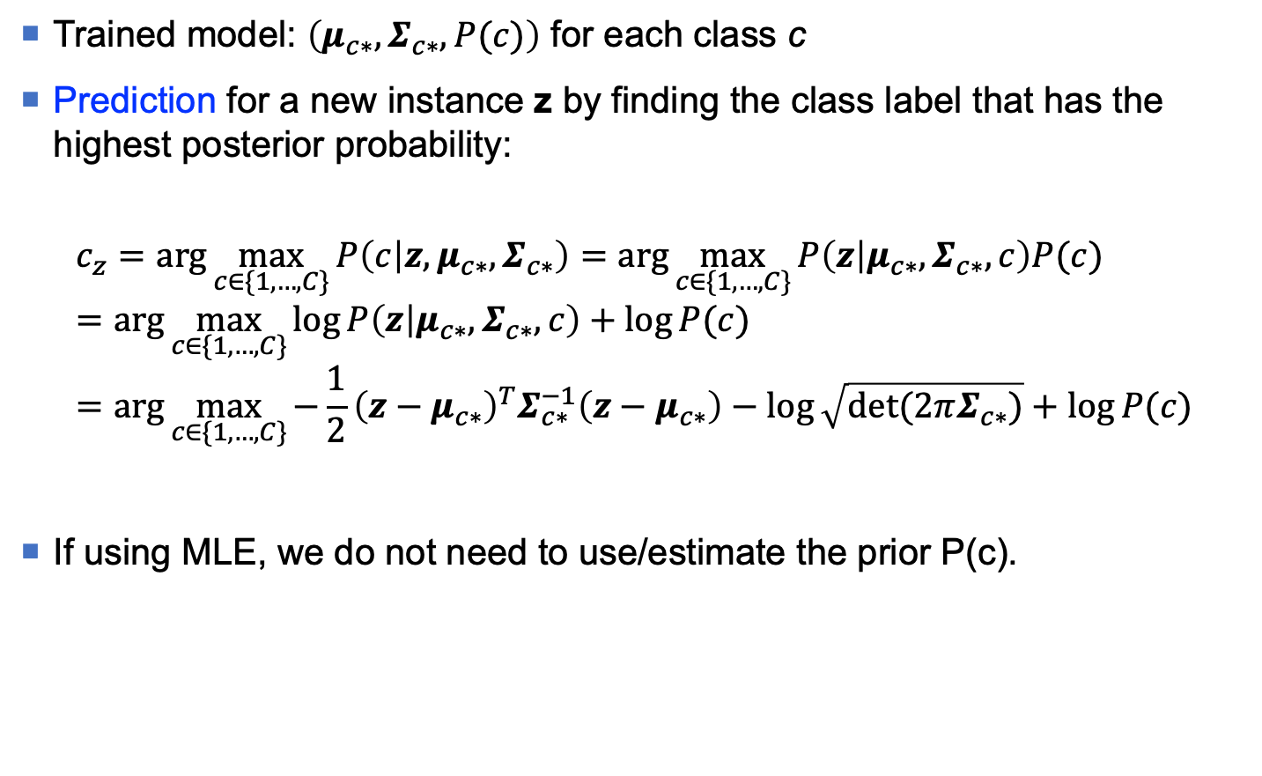
MAP: Gaussian Naïve Bayes (3)
Trained model: $\left(μ_{c∗},Σ_{c∗},P(c)\right)$ for each class c
Prediction for a new instance z by finding the class label that has the highest posterior probability:
$$c_{z}=\arg{\max_{c∈\{1,…,C\}}{P\left(c | z,μ_{c∗},Σ_{c∗}\right)}}=\arg{\max_{c∈\{1,…,C\}}{P\left(z | μ_{c∗},Σ_{c∗},c\right)P(c)}}=\arg{\max_{c∈\{1,…,C\}}{\log{P\left(z | μ_{c∗},Σ_{c∗},c\right)+\log{P(c)}}}}=\arg{\max_{c∈\{1,…,C\}}{−\frac{1}{2}{\left(z−μ_{c∗}\right)}^{T}Σ_{c∗}^{−1}\left(z−μ_{c∗}\right)−log{\sqrt{\det{(2πΣ_{c∗})}}}+\log{P(c)}}}$$
If using MLE, we do not need to use/estimate the prior P(c).
Bayes’ rule

Slide 41
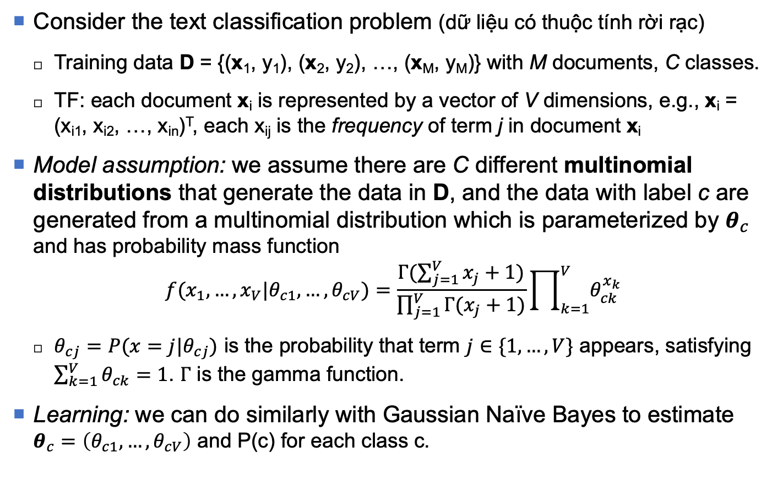
MAP: Multinomial Naïve Bayes (1)
Consider the text classification problem (dữ liệu có thuộc tính rời rạc)
Training data D = {(x₁, y₁), (x₂, y₂), …, (x_{M}, y_{M})} with M documents, C classes.
TF: each document x_{i} is represented by a vector of V dimensions, e.g., x_{i} = (x_{i1}, x_{i2}, …, x_{in})^{T}, each x_{ij} is the frequency of term j in document x_{i}
Model assumption: we assume there are C different multinomial distributions that generate the data in D, and the data with label c are generated from a multinomial distribution which is parameterized by $θ_{c}$ and has probability mass function
$${f(x_{1},…,x_{V}|θ}_{c1},…,θ_{cV})=\frac{Γ(\sum_{j=1}^{V}{x_{j}+1})}{\prod_{j=1}^{V}{Γ(x_{j}+1)}}\prod_{k=1}^{V}{θ_{ck}^{x_{k}}}$$
$θ_{cj}=P(x=j|θ_{cj})$ is the probability that term $j∈\{1,…,V\}$ appears, satisfying $\sum_{k=1}^{V}{θ_{ck}}=1$. $Γ$ is the gamma function.
Learning: we can do similarly with Gaussian Naïve Bayes to estimate $θ_{c}=\left(θ_{c1},…,θ_{cV}\right)$ and P(c) for each class c.
Homework?

Slide 42
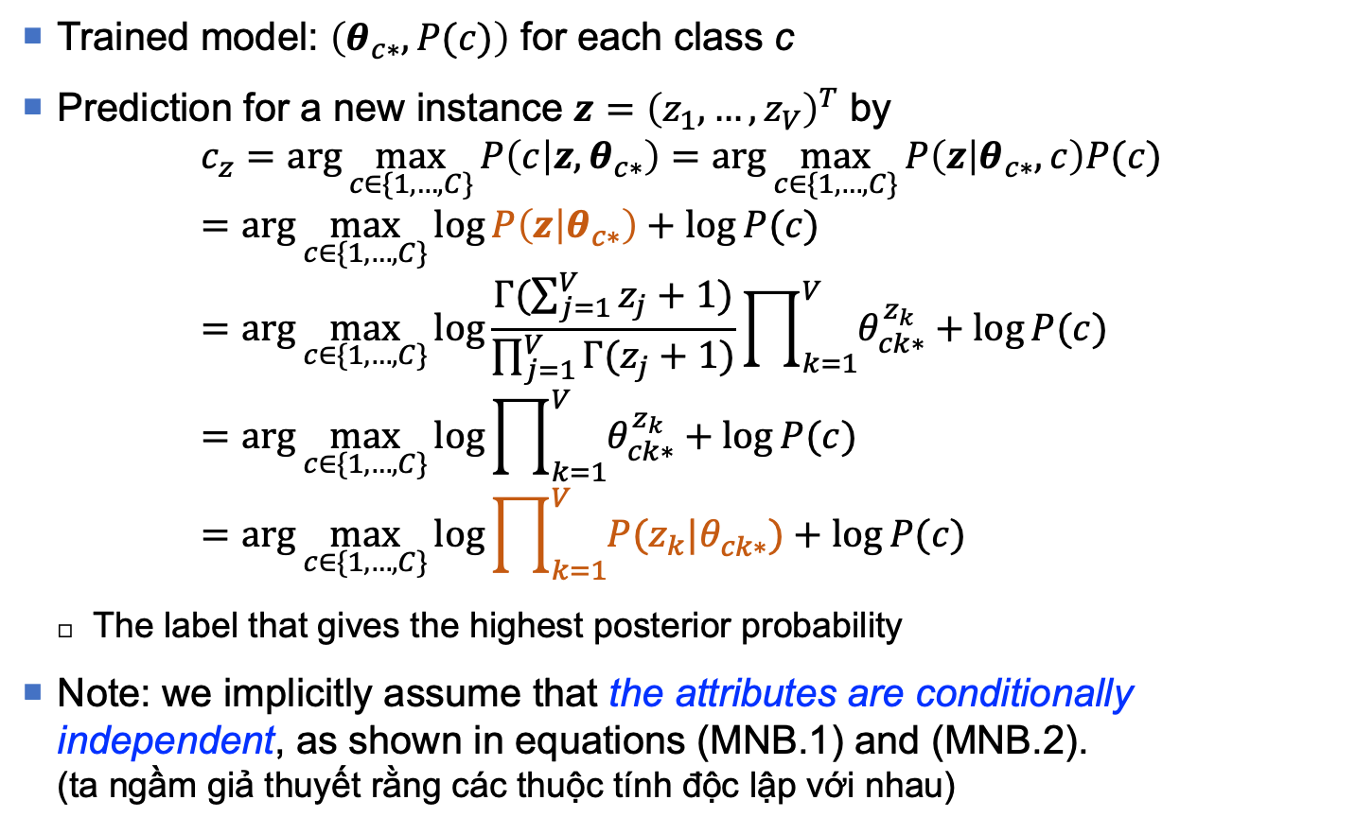
MAP: Multinomial Naïve Bayes (2)
Trained model: $\left(θ_{c∗}, P(c)\right)$ for each class c
Prediction for a new instance $z={\left(z_{1},…,z_{V}\right)}^{T}$ by
$$c_{z}=\arg{\max_{c∈\{1,…,C\}}{P\left(c | z,θ_{c∗}\right)}}=\arg{\max_{c∈\{1,…,C\}}{P\left(z | θ_{c∗},c\right)P(c)}}=\arg{\max_{c∈\{1,…,C\}}{\log{P\left(z | θ_{c∗}\right)}+\log{P(c)}}}=\arg{\max_{c∈\{1,…,C\}}{\log{\frac{Γ(\sum_{j=1}^{V}{z_{j}+1})}{\prod_{j=1}^{V}{Γ(z_{j}+1)}}\prod_{k=1}^{V}{θ_{ck∗}^{z_{k}}}}+\log{P(c)}}}=\arg{\max_{c∈\{1,…,C\}}{\log{\prod_{k=1}^{V}{θ_{ck∗}^{z_{k}}}}+\log{P(c)}}} =\arg{\max_{c∈\{1,…,C\}}{\log{\prod_{k=1}^{V}{{P(z_{k}|θ}_{ck∗}^{})}}+\log{P(c)}}}$$
The label that gives the highest posterior probability
Note: we implicitly assume that the attributes are conditionally independent, as shown in equations (MNB.1) and (MNB.2). (ta ngầm giả thuyết rằng các thuộc tính độc lập với nhau)
(MNB.1)
(MNB.2)

Slide 43
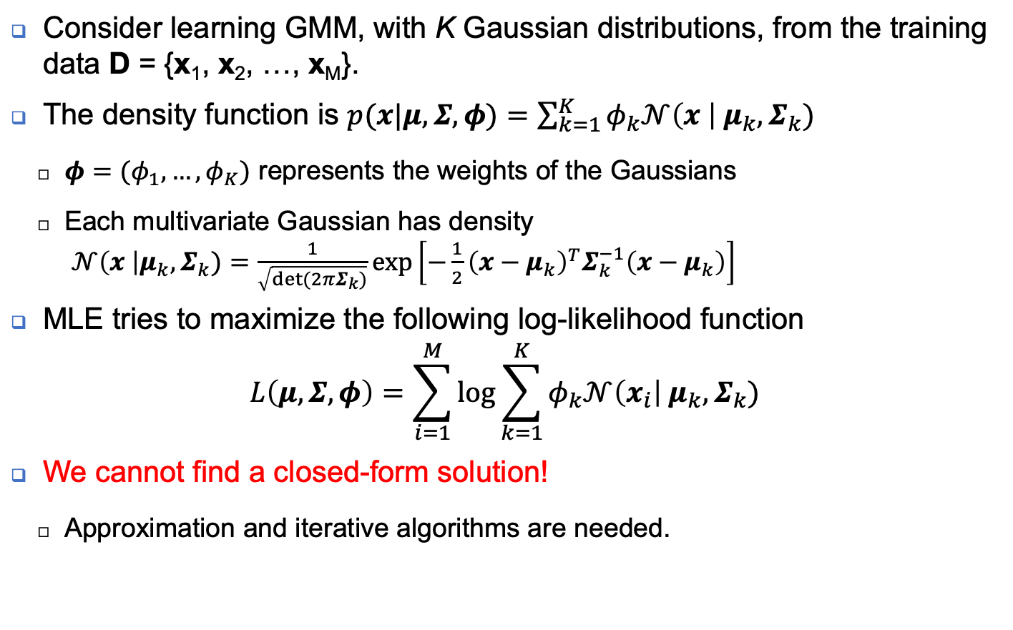
A revisit to GMM
Consider learning GMM, with K Gaussian distributions, from the training data D = {x₁, x₂, …, x_{M}}.
The density function is $p(x|μ,Σ,φ)=\sum_{k=1}^{K}{φ_{k}𝒩\left(x \right|{ μ}_{k}, Σ_{k})}$
$φ=(φ_{1},…,φ_{K})$ represents the weights of the Gaussians
Each multivariate Gaussian has density $𝒩\left(x \right|μ_{k},Σ_{k})=\frac{1}{\sqrt{det⁡(2πΣ_{k})}}exp⁡\left[−\frac{1}{2}{\left(x−μ_{k}\right)}^{T}Σ_{k}^{−1}\left(x−{ μ}_{k}\right)\right]$
MLE tries to maximize the following log-likelihood function
$$L\left(μ,Σ,φ\right)=\sum_{i=1}^{M}{\log{\sum_{k=1}^{K}{φ_{k}𝒩\left(x_{i}\right|{ μ}_{k}, Σ_{k})}}}$$
We cannot find a closed-form solution!
Approximation and iterative algorithms are needed.

Slide 44
Difficult situations
No closed-form solution for the learning/inference problem? (không tìm được ngay công thức nghiệm)
The examples before are easy cases, as we can find solutions in a closed form by using gradient.
Many models (e.g., GMM) do not admit a closed-form solution.
No explicit expression of the density/mass function? (không có công thức tường minh để tính toán)
Intractable inference (bài toán suy diễn không khả thi)
Inference in many probabilistic models is NP-hard. [Sontag & Roy, 2011; Tosh & Dasgupta, 2019]

Slide 45
Reference
Blei, David M., Alp Kucukelbir, and Jon D. McAuliffe. "Variational inference: A review for statisticians." Journal of the American Statistical Association 112, no. 518 (2017): 859-877.
Blundell, Charles, Julien Cornebise, Koray Kavukcuoglu, and Daan Wierstra. "Weight Uncertainty in Neural Network." In International Conference on Machine Learning (ICML), pp. 1613-1622. 2015.
Gal, Yarin, and Zoubin Ghahramani. "Dropout as a bayesian approximation: Representing model uncertainty in deep learning." In International Conference on Machine Learning, pp. 1050-1059. 2016.
Ghahramani, Zoubin. "Probabilistic machine learning and artificial intelligence." Nature 521, no. 7553 (2015): 452-459.
Kingma, Diederik P., and Max Welling. "Auto-encoding variational bayes.” In International Conference on Learning Representations (ICLR), 2014.
Jordan, Michael I., and Tom M. Mitchell. "Machine learning: Trends, perspectives, and prospects." Science 349, no. 6245 (2015): 255-260.
Tosh, Christopher, and Sanjoy Dasgupta. “The Relative Complexity of Maximum Likelihood Estimation, MAP Estimation, and Sampling.” In Proceedings of the 32nd Conference on Learning Theory, in PMLR 99:2993-3035, 2019.
Sontag, David, and Daniel Roy, “Complexity of inference in latent dirichlet allocation” in: Proceedings of Advances in Neural Information Processing System, 2011.

